Slide 1
Deep seas \ systems \ strategy \ interaction\
Systems Dramaturgy.
varad.
mscdp.gsapp.

Slide 2
"Ships move through corridors 33 kilometers wide.
20% of the world's oil. Every day.
Built to understand trade.
Ended up understanding power."

Slide 3
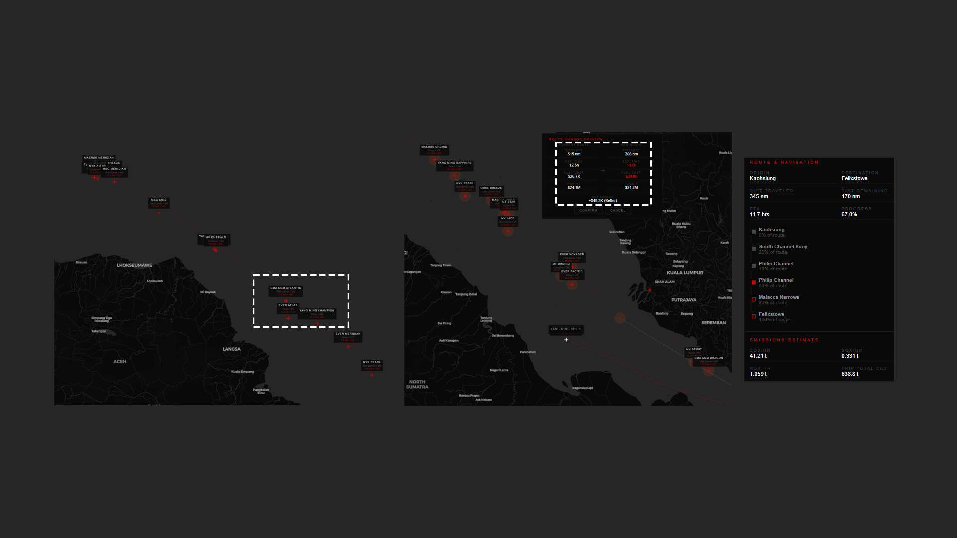

Slide 4
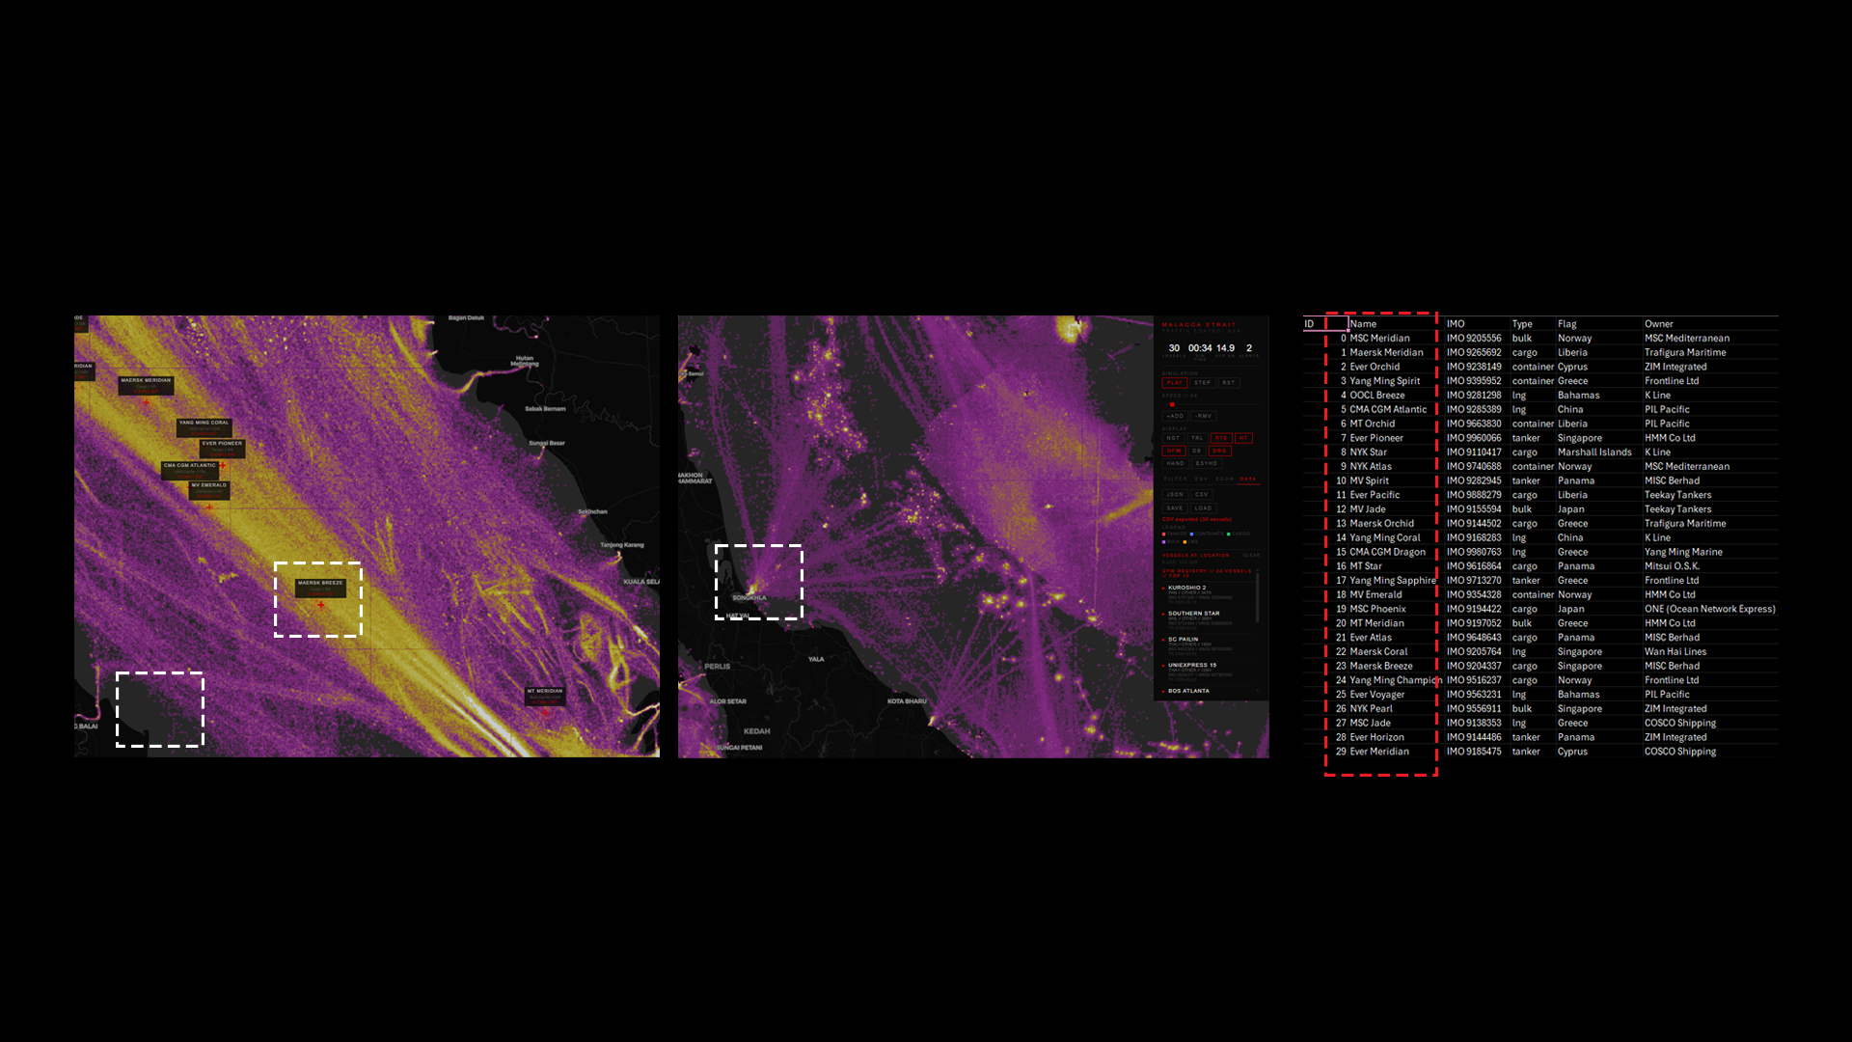

Slide 5
"April 2024. Iran attacks Israel.
$155 million had already been bet on whether it would happen.
The market knew before the missiles launched.
The physical event was almost irrelevant by the time it happened."

Slide 6
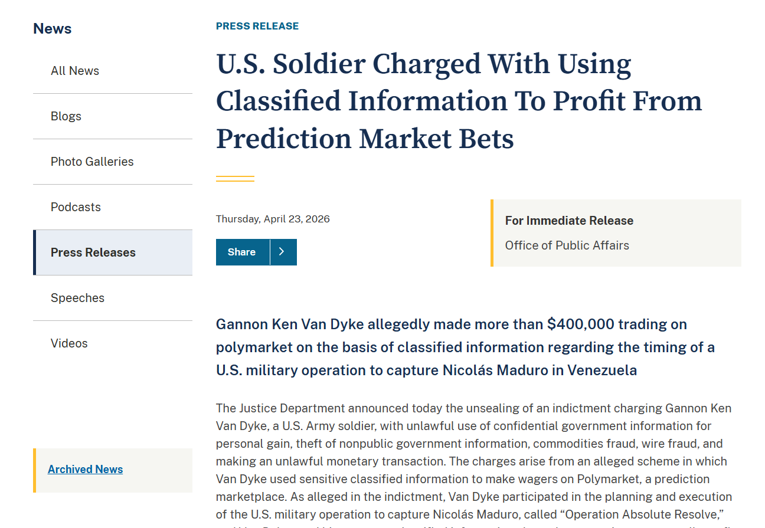

Slide 7
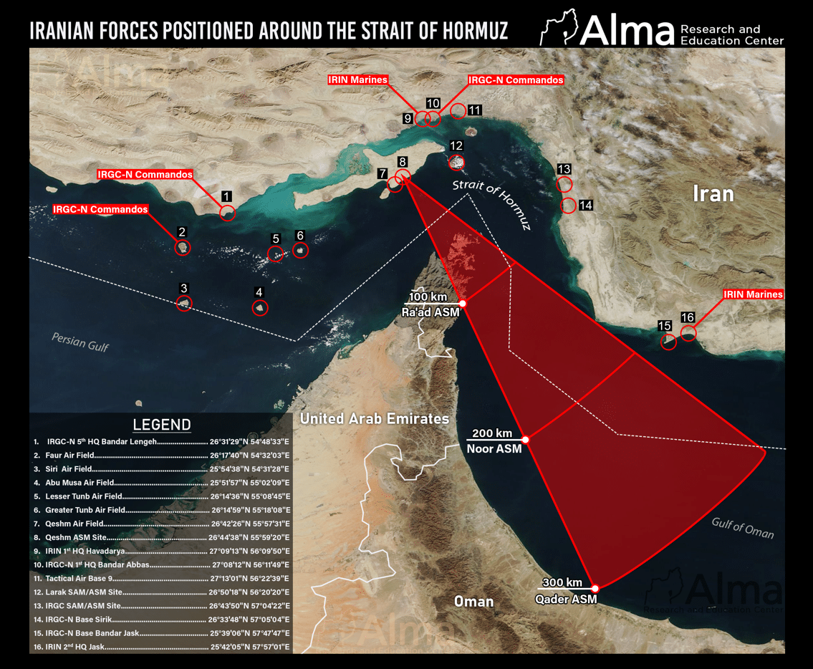

Slide 8
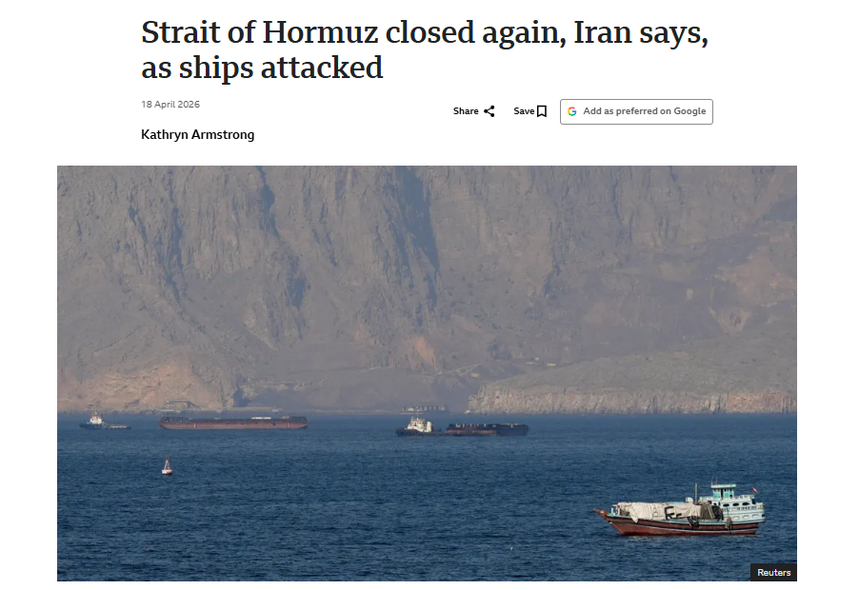

Slide 9
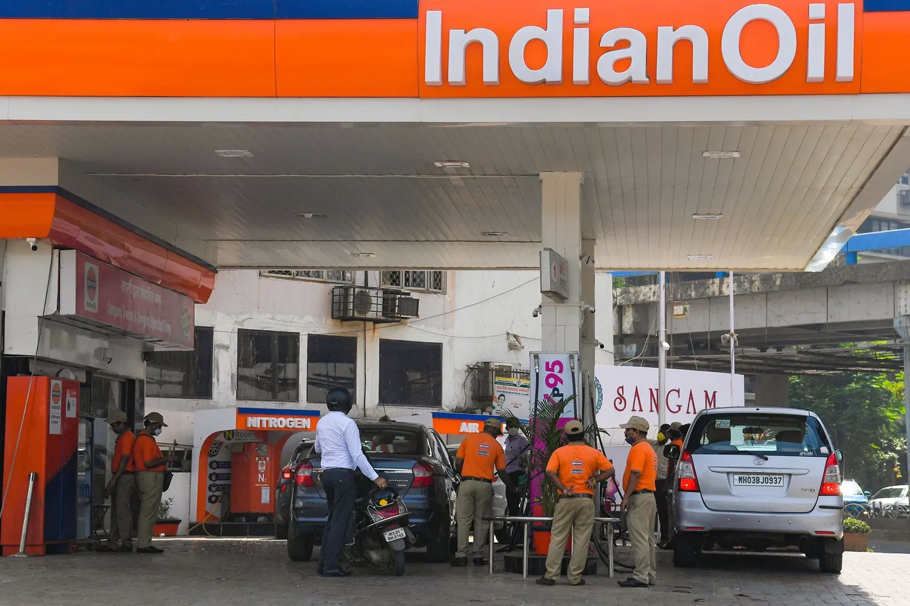
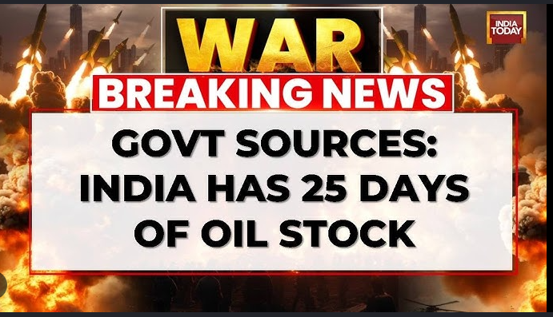

Slide 10
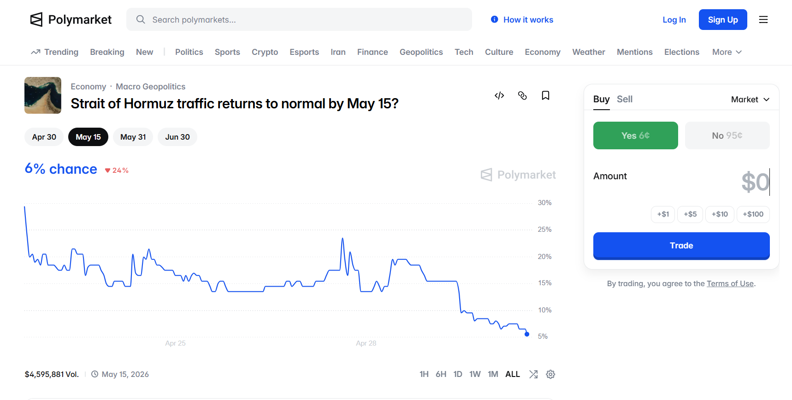

Slide 11
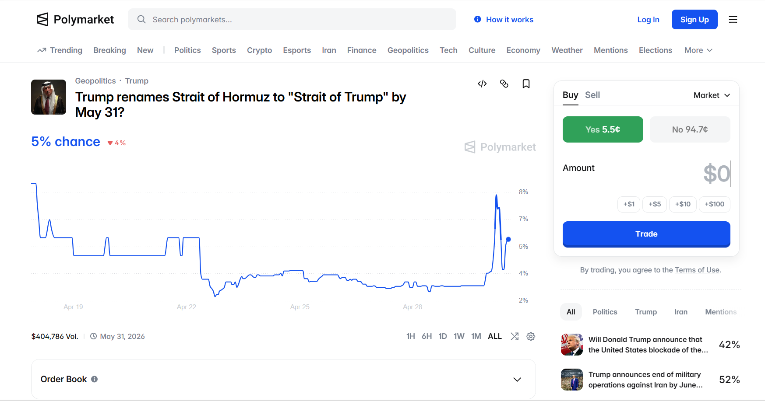

Slide 12




Slide 13
<why?>
"The mismatch between who has information and who bears the consequences is right there in the numbers.
Nobody hid it.
They just assumed you wouldn't look.
This is what it looks like when you do."

Slide 14
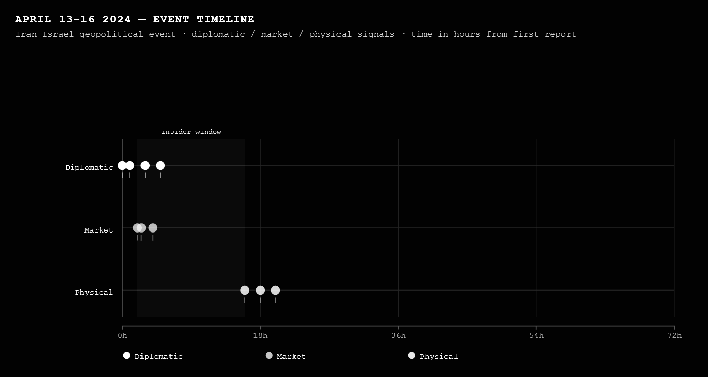
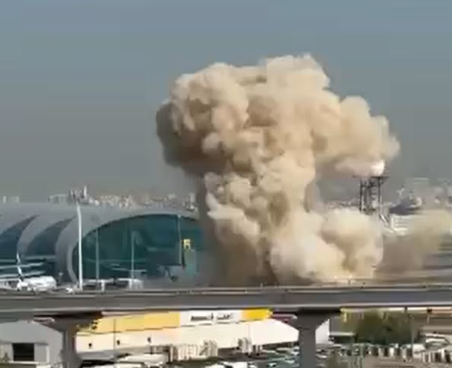
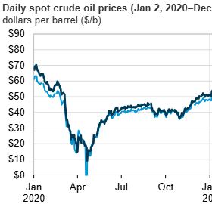
Iran gave regional countries hosting US military bases 72 hours notice of the imminent attack via diplomatic channels, this happened before any public reporting. That 72-hour window is your insider window. The people who knew were already positioning.
Traders put down large sums on potential Israeli and Iranian intervention, including one market whose volume ballooned to $155 million. The market knew. The market was moving money. The physical event had not happened yet.
More than 300 projectiles, including around 170 drones and over 120 ballistic missiles, were fired toward Israel overnight, but 99% were intercepted. CNN - Crude prices rose to their highest level in months after the attack, but the response was relatively muted because the market had already priced in the risk. One analyst said directly: "the threat of retaliation has increased the risk, but the response this morning suggests some of that risk had already been priced in."

Slide 15
I didn't invent this.
I just started looking at it
long enough to see the shape.
most people never look long enough
Not because they're not smart.
Because the system doesn't need them to.
Invisibility is a feature, not a bug.
"The spike is not insight. It's the echo of someone else's trade."

Slide 16
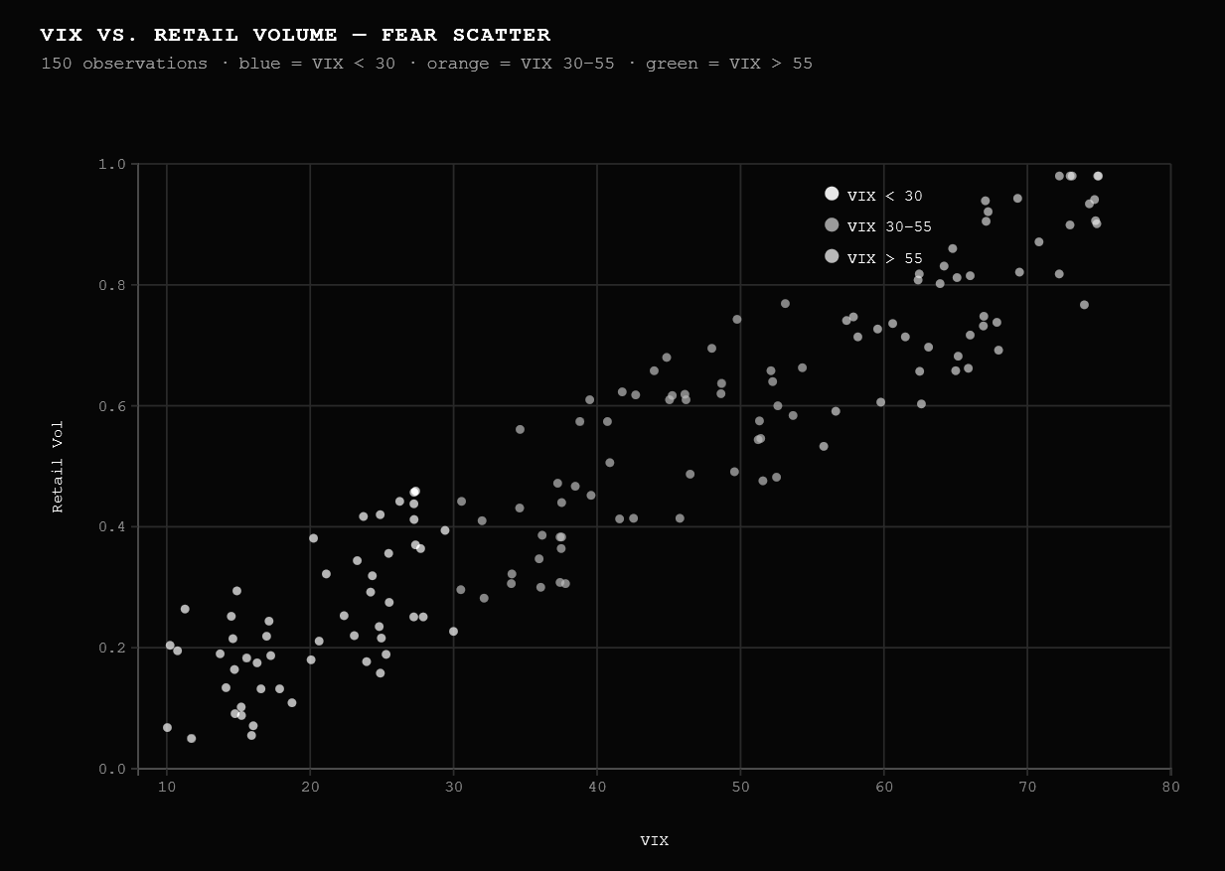
VIX on the x-axis is fear. Retail volume on the y-axis is how much ordinary people are buying and selling. The dots slope upward right ,more fear, more trading.
VIX < 20 → calm, low anxiety, normal conditions
VIX 20–30 → elevated uncertainty, something is happening
VIX 30–55 → genuine fear, crisis conditions (COVID crash hit ~85, 2008 hit ~80)
VIX > 55 → extreme panic, rare

Slide 17
Same event. Two experiences.
One group is figuring out what happened.
The other already knows what comes next.
They're not wrong, exactly.
They're just working from
the wrong set of facts.
This is what speculation looks like from the inside:
it feels exactly like knowledge.

Slide 18
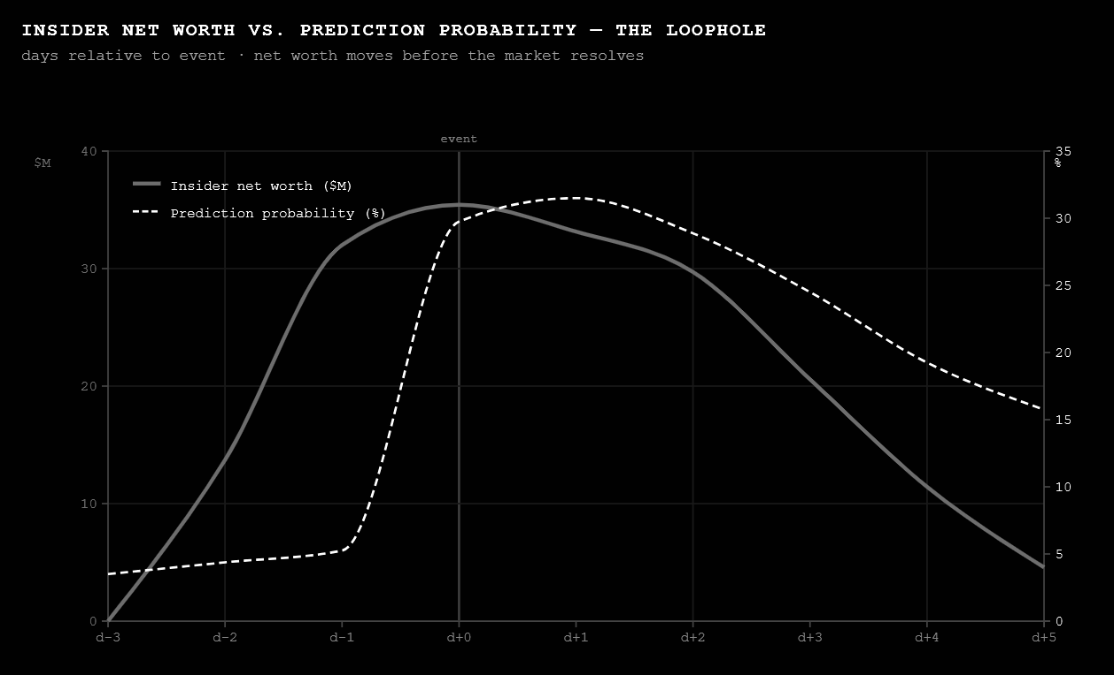

Slide 19
What if the system showed you the room?
What if you were the one who knew first?
What would you do with that?

Slide 20
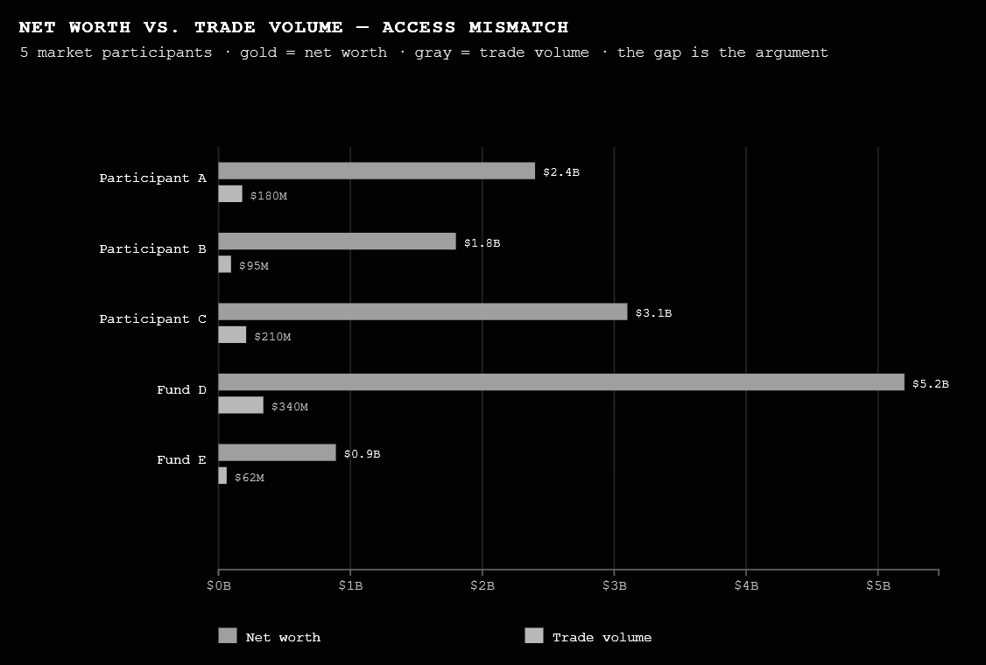

Slide 21
What if the system showed you the room?
What if you were the one who knew first?
What would you do with that?

Slide 22
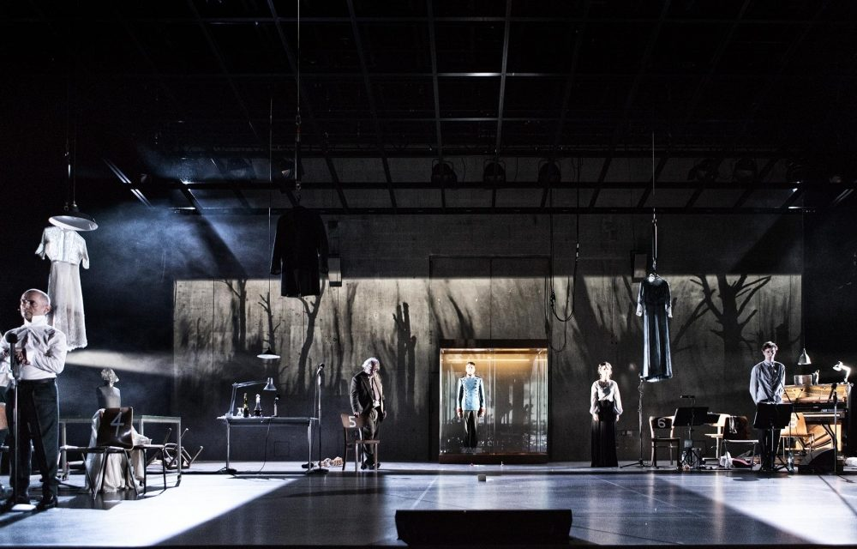
How do I engage? -
Systems dramaturgy
The practice of designing systems whose structure of experience is the argument, so the person inside it doesn't need to be told what it means. They've already felt it.

Slide 23
What am I asking?
Does information asymmetry determine market outcomes more than underlying event itself?
At what point does the market stop reflecting the game and start determining it?

